Slide 1
Face Recognition using MLC’s
Raghunath Sai Puttagunta
Student no-16207717

Slide 2
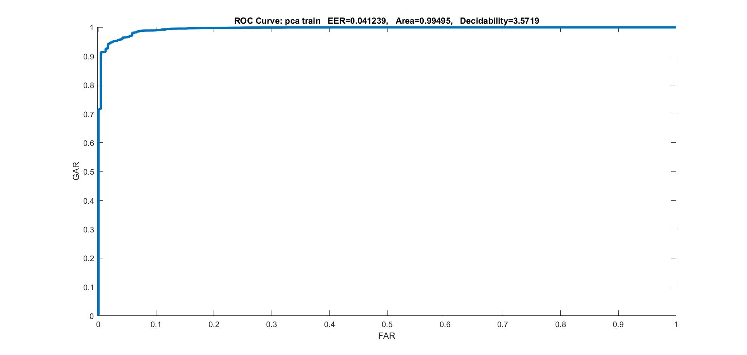
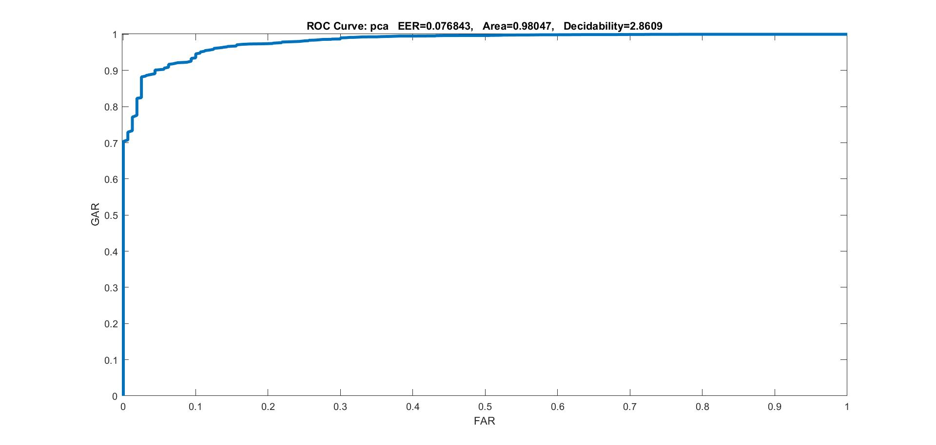
PCA
PCA Train
EER-0.042139
AUC-0.99495
Decidability-3.5719
PCA Test
EER-0.076843
AUC-0.98047
decidability-2.8069

Slide 3
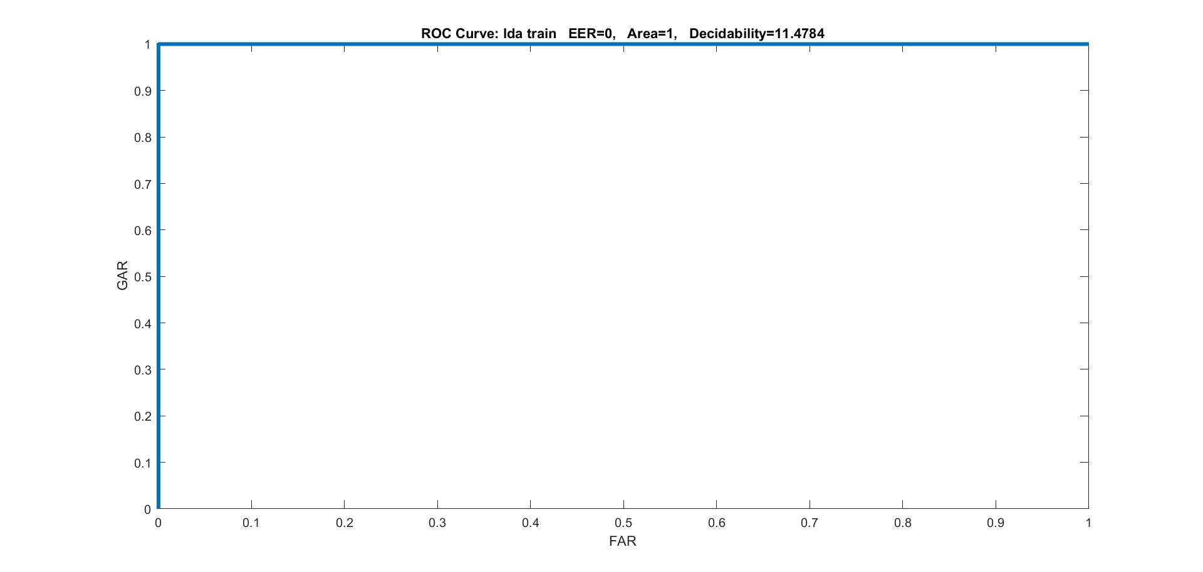
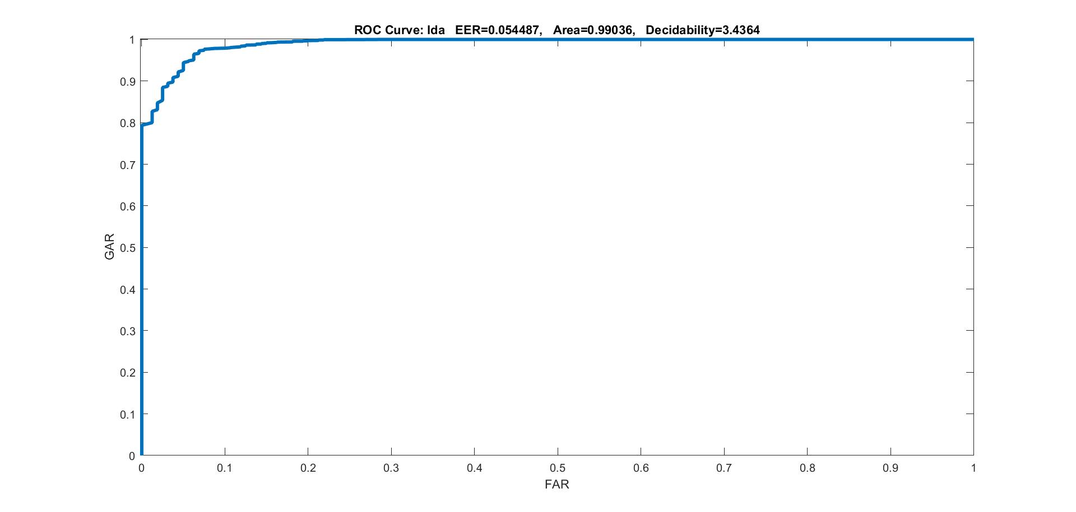
LDA
LDA Train LDA Test
EER-0 EER-0.05447
AUC-1 AUC-0.99036
Decidability-11.4784 Decidability-3.4364

Slide 4
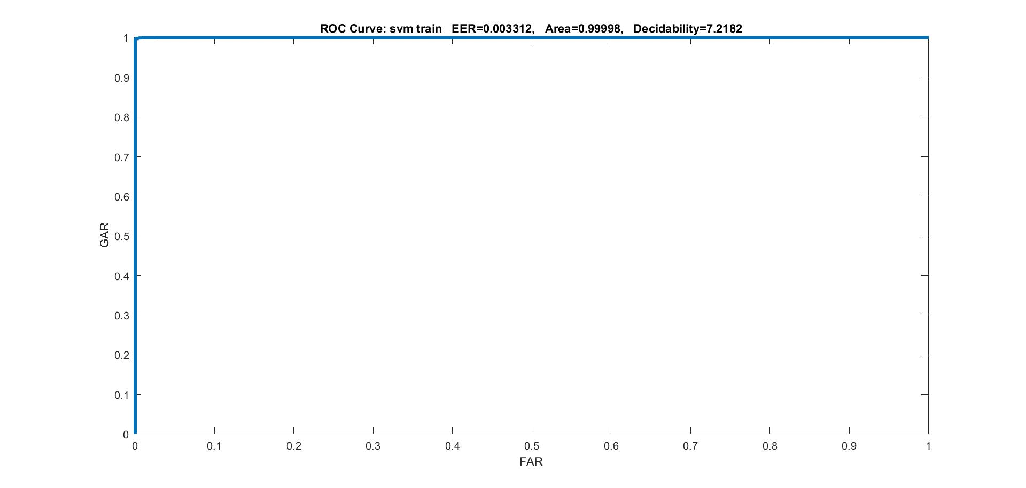
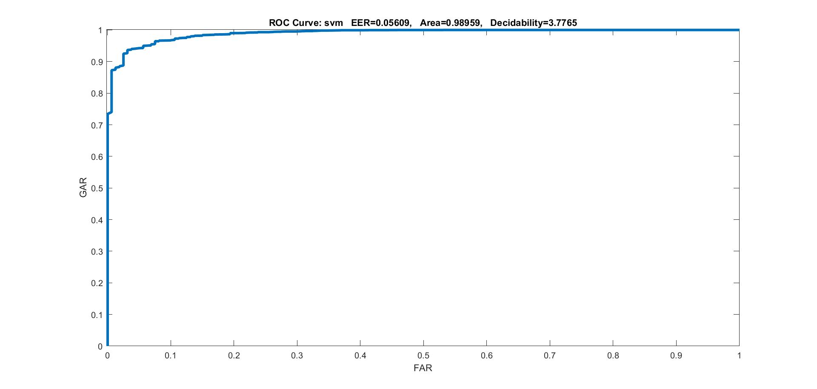
SVM
SVM Train
EER-0.003312
AUC-0.99998
Decidability-7.2182
SVM Test
EER-0.05609
AUC-0.98959
Decidability-3.7765

Slide 5
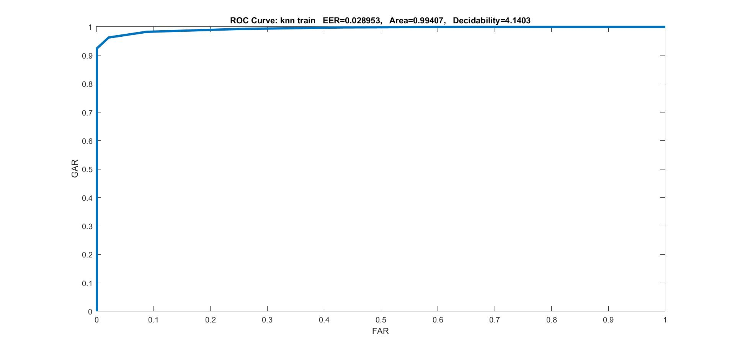

KNN
KNN Train
EER-0.028953
AUC-0.99407
Decidability-4.1403
KNN Test
EER-0.069872
AUC-0.98394
Decidability-2.9791

Slide 6
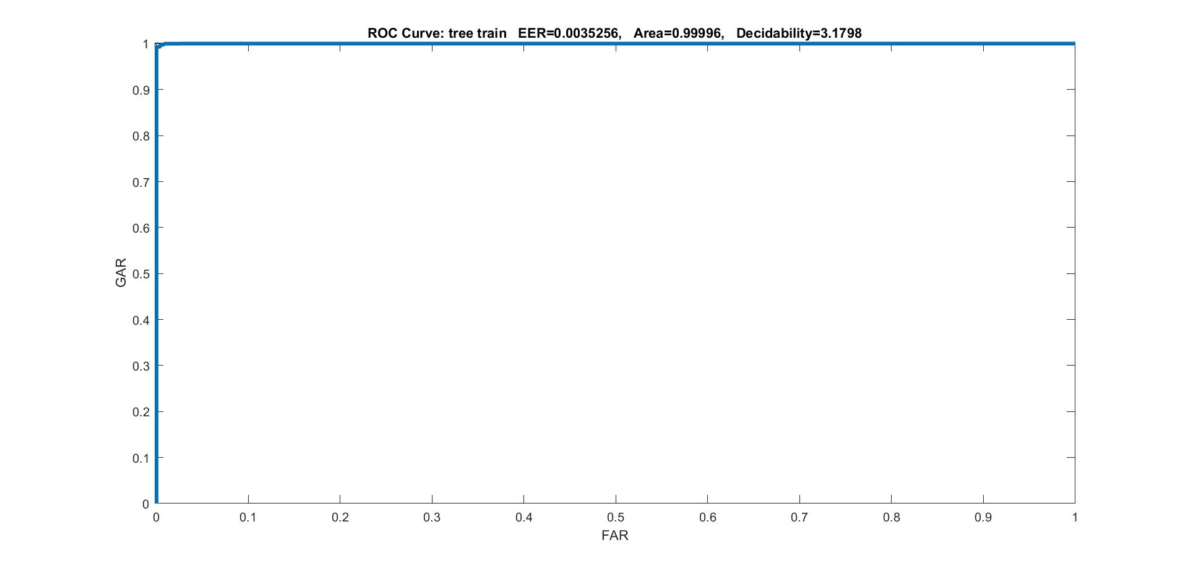
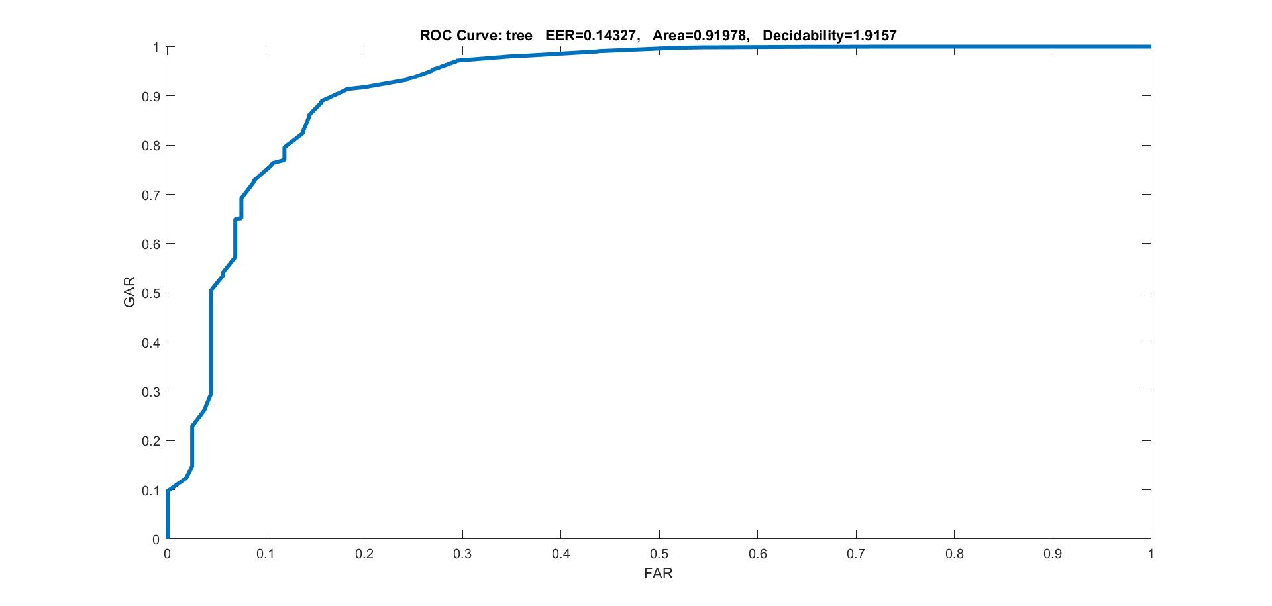
TREE
Tree Train
EER-0.0035256
AUC-0.99996
Decidability-3.1798
Tree Test
EER-0.14327
AUC-0.91978
Decidability-1.9157

Slide 7
Sum rule
 | EER | AUC | Decidability
LDA+PCA+SVM+KNN+TREE | 0.055449 | 0.99114 | 3.8892
LDA+PCA+SVM+KNN | 0.032162 | 0.99598 | 4.1898
LDA+SVM+KNN | 0.03109 | 0.99629 | 4.216
LDA+SVM+PCA | 0.03726 | 0.99548 | 4.0579
PCA+SVM+KNN | 0.38031 | 0.99315 | 3.9862
LDA+PCA+KNN | 0.030048 | 0.9957 | 3.9224

Slide 8
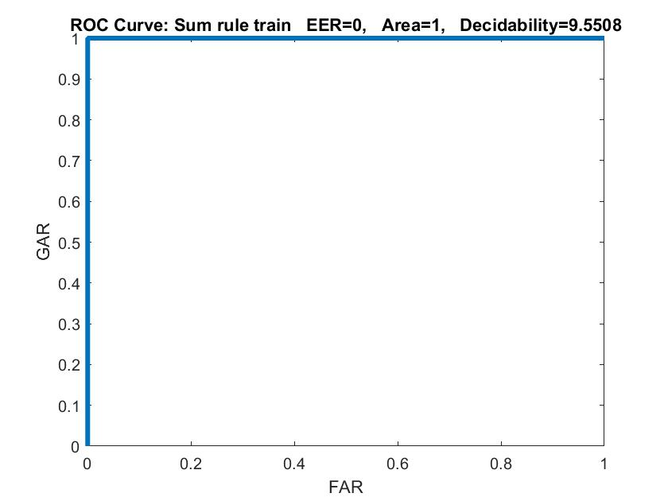
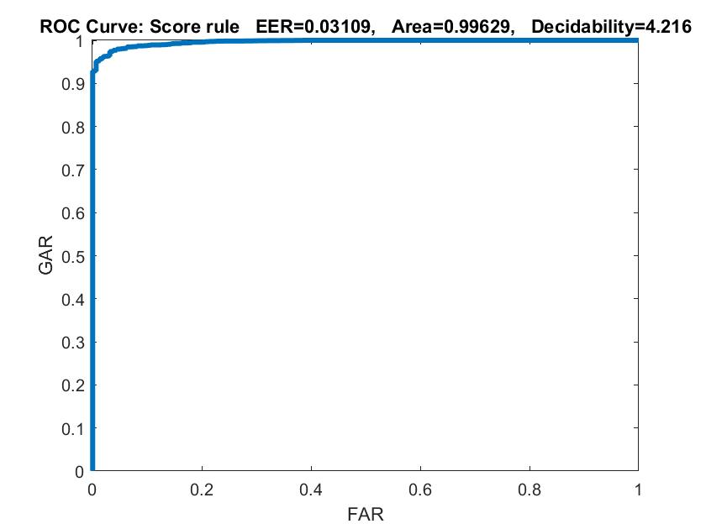
Sum rule
LDA+SVM+KNN train
LDA+SVM+KNN test

Slide 9
Max rule
 | EER | AUC | Decidability
LDA+PCA+SVM+KNN+TREE | 0.069872 | 0.98451 | 2.9844
LDA+PCA+SVM+KNN | 0.069872 | 0.98481 | 3.0145
LDA+SVM+KNN | 0.069872 | 0.98481 | 3.0145
LDA+SVM+PCA | 0.03726 | 0.99447 | 3.7048
PCA+SVM+KNN | 0.069872 | 0.98407 | 2.9836
LDA+PCA+KNN | 0.069872 | 0.98474 | 3.0147

Slide 10
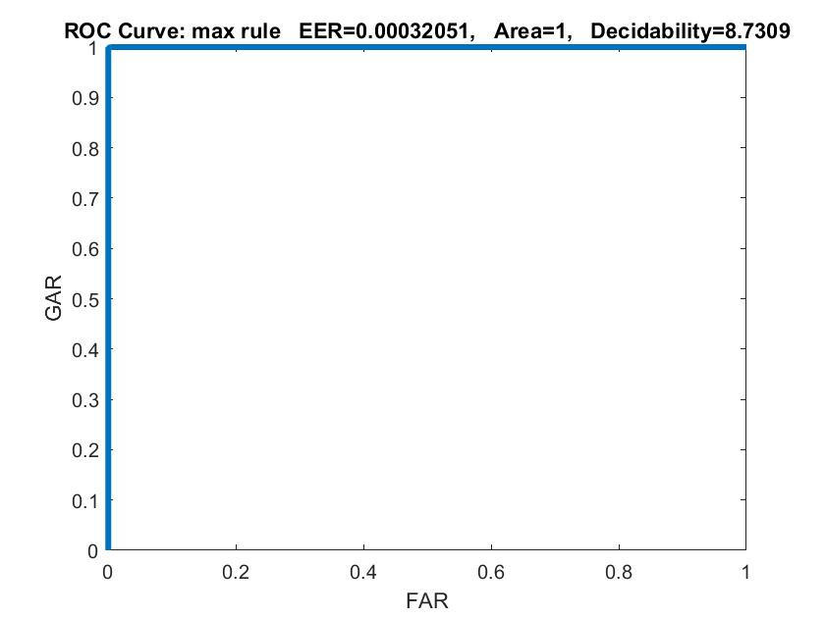
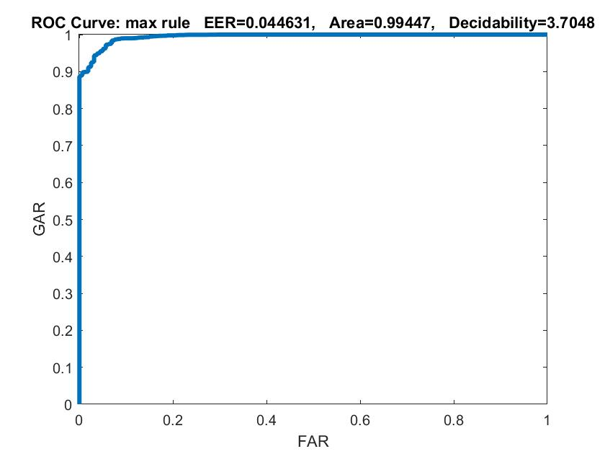
Max rule
LDA+SVM+PCA train
LDA+SVM+PCA test

Slide 11
Min rule
 | EER | AUC | Decidability
LDA+PCA+SVM+KNN+TREE | 0.1121 | 0.96154 | 2.6587
LDA+PCA+SVM+KNN | 0.061298 | 0.98871 | 3.3018
LDA+SVM+KNN | 0.049679 | 0.99156 | 3.8998
LDA+SVM+PCA | 0.061298 | 0.98871 | 3.3018
PCA+SVM+KNN | 0.061218 | 0.98868 | 3.27
LDA+PCA+KNN | 0.079167 | 0.98196 | 2.9589

Slide 12
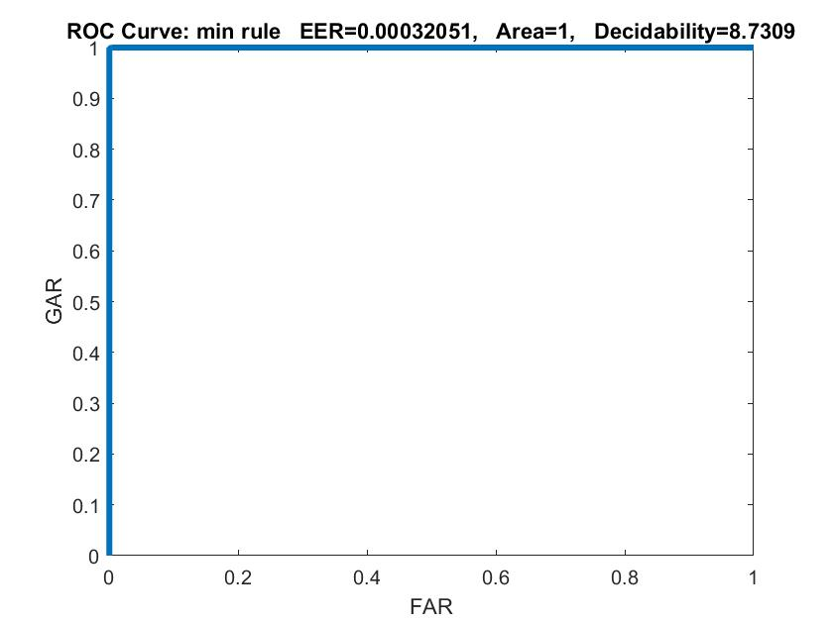
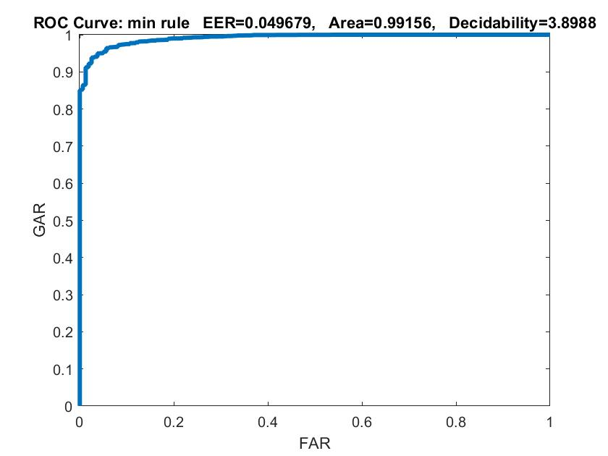
Min rule
LDA+SVM+KNN train
LDA+SVM+KNN test

Slide 13
Product rule
 | EER | AUC | Decidability
LDA+PCA+SVM+KNN+TREE | 0.062901 | 0.98728 | 1.9445
LDA+PCA+SVM+KNN | 0.041026 | 0.99554 | 3.0554
LDA+SVM+KNN | 0.03149 | 0.99594 | 4.2332
LDA+SVM+PCA | 0.042708 | 0.99484 | 3.0254
PCA+SVM+KNN | 0.04359 | 0.99337 | 3.3313
LDA+PCA+KNN | 0.03734 | 0.99503 | 3.4912

Slide 14
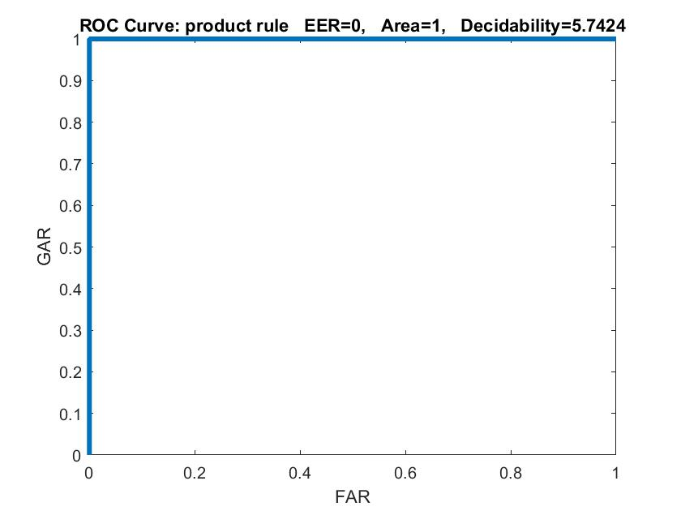
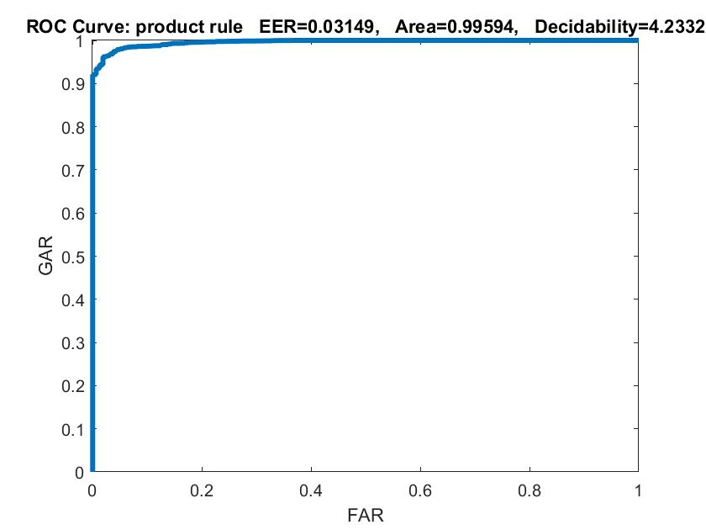
Product rule
LDA+PCA+SVM+KNN train
LDA+PCA+SVM+KNN test

Slide 15
Median rule
 | EER | AUC | Decidability
LDA+PCA+SVM+KNN+TREE | 0.05649 | 0.98775 | 3.7654
LDA+PCA+SVM+KNN | 0.037099 | 0.99569 | 4.1851
LDA+SVM+KNN | 0.04383 | 0.99511 | 3.8106
LDA+SVM+PCA | 0.045112 | 0.99148 | 4.0147
PCA+SVM+KNN | 0.04984 | 0.98961 | 3.7942
LDA+PCA+KNN | 0.049038 | 0.99249 | 3.6379

Slide 16

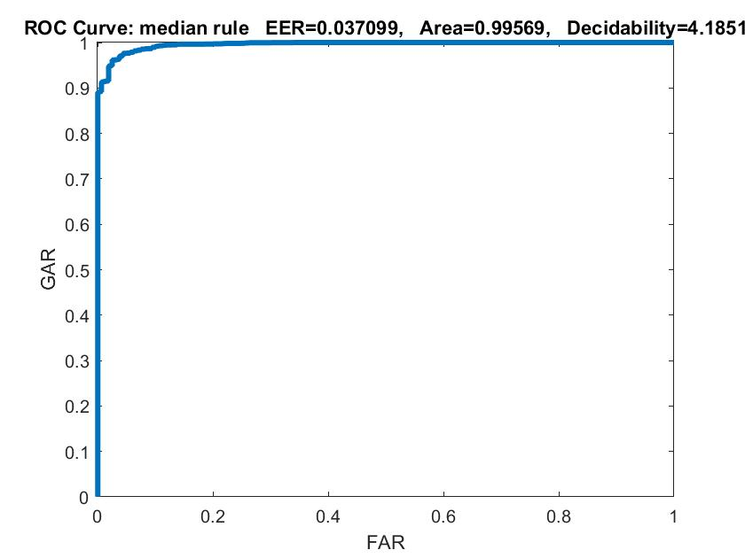
Median rule
LDA+PCA+SVM+KNN train
LDA+PCA+SVM+KNN test

Slide 17
Weighted Rule
LDA+SVM+KNN
a1 | a2 | a3 | EER | AUC | Decidability
0.3 | 0.2 | 0.5 | 0.032372 | 0.99553 | 4.0243
0.4 | 0.2 | 0.4 | 0.03117 | 0.99659 | 4.1417
0.5 | 0.2 | 0.3 | 0.02492 | 0.99725 | 4.189
0.6 | 0.2 | 0.2 | 0.030929 | 0.99738 | 4.1515
0.5 | 0.4 | 0.1 | 0.031571 | 0.99637 | 4.1653
0.4 | 0.4 | 0.2 | 0.03109 | 0.99638 | 4.2312
0.3 | 0.4 | 0.3 | 0.03133 | 0.99589 | 4.2211
0.1 | 0.4 | 0.5 | 0.04367 | 0.9939 | 4.01
0.6 | 0.1 | 0.3 | 0.02484 | 0.99749 | 4.0876
0.7 | 0.1 | 0.2 | 0.030288 | 0.99739 | 4.0221

Slide 18
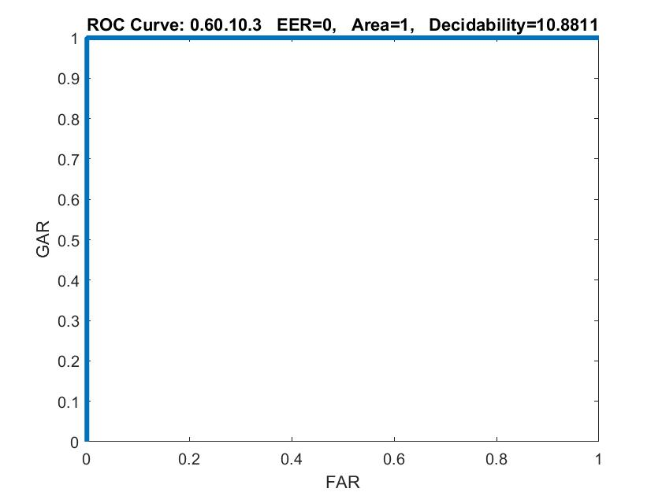
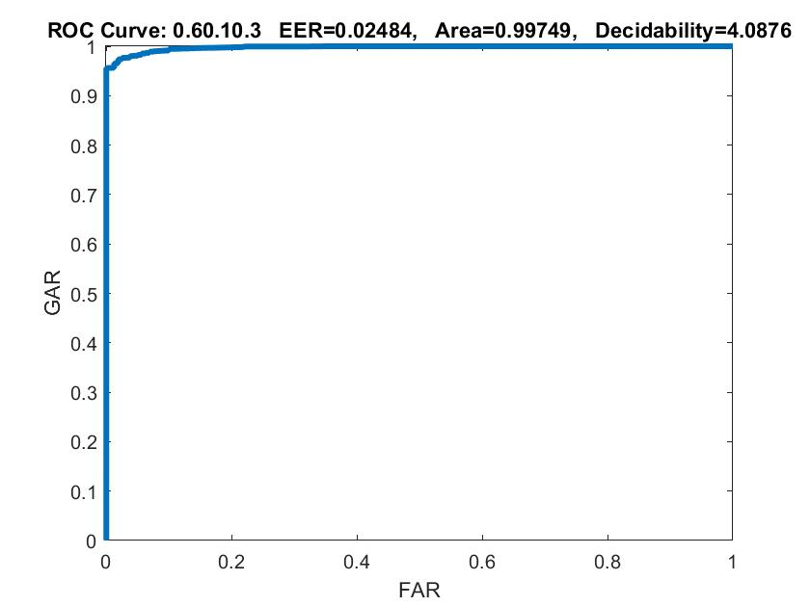
Weighted Rule
LDA+KNN+SVM Train
LDA+KNN+SVM Test

